Slide 1
Group 1
PROJECT PROPOSAL
106-1 10/5 Software Engineering Design

Slide 2

Project Reviewed
Teammates
Student peer evaluations/feedback,
shareable instructor comments,
and more...
Guava
Google Core Libraries for Java

Slide 3
TEAMMATES
Introduction
Users
Lines of codes
Education Management Information System
Java, JSP, JavaScript, CSS, HTML
Contributors : School of Computing, National University of Singapore (NUS)
Features : Student peer evaluations/feedback

Slide 4
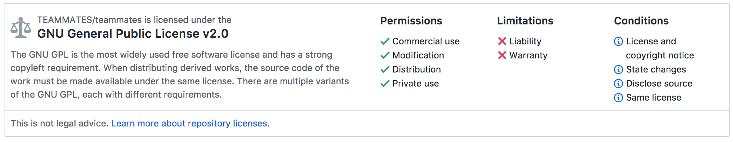
TEAMMATES
Introduction
Users
Lines of codes
License : GPL v2

Slide 5
TEAMMATES
Introduction
Users
Lines of codes
Instructors
Add/Search course
Add Feedback Session
Enroll Student
Students
Submit feedback
View response
Administrators
Add instructors/students

Slide 6
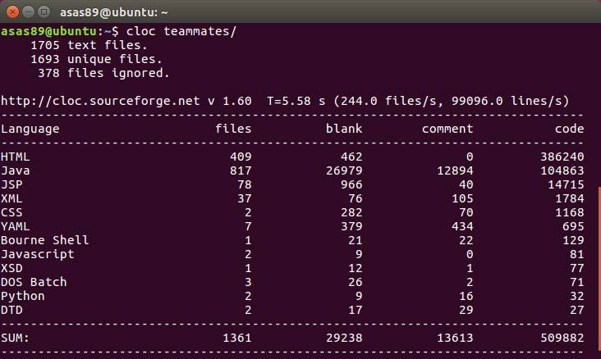
TEAMMATES
Introduction
Users
Lines of codes

Slide 7
Guava: Introduction
Introduction
Basic Utilities
Line of codes
Collections
Graphs
Caches
Concurrency
Strings
Networking
Primitives
Ranges
I/O
Hashing
EventBus
Math
Reflection
The Guava project contains several of Google's core libraries that we rely on in our Java-based projects
The standard JCF does not provide sufficient functionality. This fact led two engineers to develop an extension to JCF, which provides additional generic classes such as multisets, multimaps, bimaps, and immutable collections.
Guava was the 8th most popular Java library according to a Research performed in 2013 on 10,000 GitHub projects.
Support for Guava has been dropped from version 5 of the Spring Framework.

Slide 8
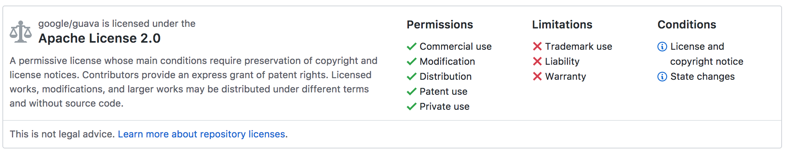
Guava: Introduction
Introduction
Basic Utilities
Line of codes
Collections
Graphs
Caches
Concurrency
Strings
Networking
Primitives
Ranges
I/O
Hashing
EventBus
Math
Reflection
License: Apache License 2.0

Slide 9
Basic Utilities
Introduction
Basic Utilities
Line of codes
Collections
Graphs
Caches
Concurrency
Strings
Networking
Primitives
Ranges
I/O
Hashing
EventBus
Math
Reflection
Using/avoiding null
Preconditions
Ordering
Object methods
Throwables

Slide 10
Basic Utilities (1/5) ----Using/avoiding null
Introduction
Basic Utilities
Line of codes
Collections
Graphs
Caches
Concurrency
Strings
Networking
Primitives
Ranges
I/O
Hashing
EventBus
Math
Reflection
95% of collections weren't supposed to have any null values in them, and having those fail fast rather than silently accept null would have been helpful to developers.
Null is unpleasantly ambiguous. E.g. Map.get(key)
Optional
It forces you to actively think about the absent case if you want your program to compile at all.

Slide 11
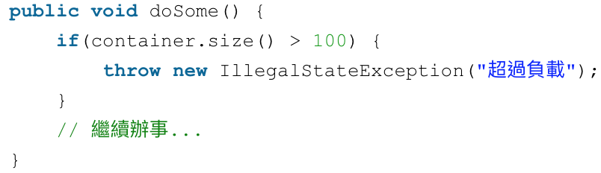
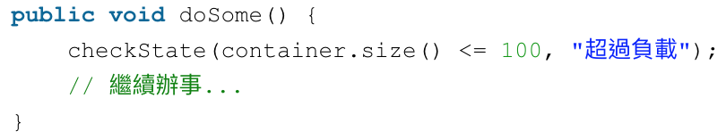
Basic Utilities (2/5) ----Preconditions
Introduction
Basic Utilities
Line of codes
Collections
Graphs
Caches
Concurrency
Strings
Networking
Primitives
Ranges
I/O
Hashing
EventBus
Math
Reflection
The Preconditions class provides a list of static methods for checking that a method or a constructor is invoked with valid parameter values. If a precondition fails, a tailored exception is thrown.
Without guava
With guava

Slide 12
Basic Utilities (3/5) ----Ordering
Introduction
Basic Utilities
Line of codes
Collections
Graphs
Caches
Concurrency
Strings
Networking
Primitives
Ranges
I/O
Hashing
EventBus
Math
Reflection
It is Guava's "fluent" Comparator class, which can be used to build complex comparators and apply them to collections of objects.
Creation
Common orderings are provided by static method
E.g. natual(), usingToString() …
Chaining
A given Ordering can be wrapped to obtain derived orderings.
E.g. reverse(), nullFirst() …
Application
Guava provides a number of methods to manipulate or examine values or collections using the ordering.
E.g. greatestOf(), min(), isOrdered() …

Slide 13
Basic Utilities (4/5) ----Object methods
Introduction
Basic Utilities
Line of codes
Collections
Graphs
Caches
Concurrency
Strings
Networking
Primitives
Ranges
I/O
Hashing
EventBus
Math
Reflection
equals
Using Objects.equal lets you perform equalschecks in a null-sensitive way, without risking a NullPointerException.
hashCode
Hashing all the fields of an Object should be simpler, but similar with JDK 7.
toString
A good toString method can be invaluable in debugging, but is a pain to write. Use MoreObjects.toStringHelper to easily create a useful toString.
Compare/compareTo
ComparisonChain performs a "lazy" comparison: it only performs comparisons until it finds a nonzero result, after which it ignores further input.

Slide 14
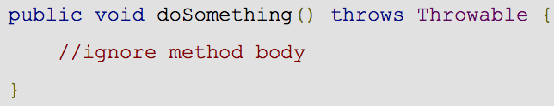
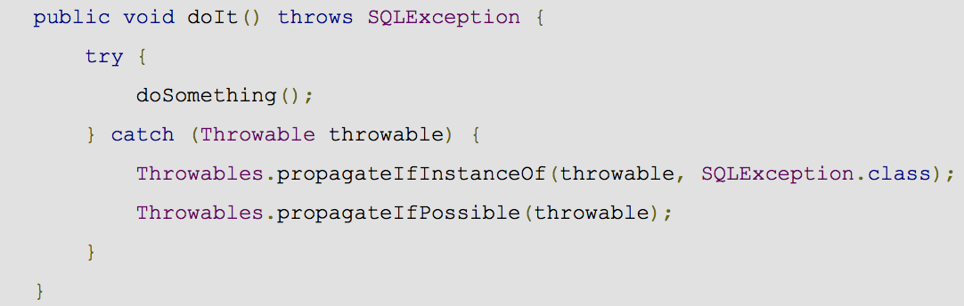
Basic Utilities (5/5) ----Throwables
Introduction
Basic Utilities
Line of codes
Collections
Graphs
Caches
Concurrency
Strings
Networking
Primitives
Ranges
I/O
Hashing
EventBus
Math
Reflection
Sometimes, when you catch an exception, you want to throw it back up to the next try/catch block. This is frequently the case for RuntimeException or Error instances, which do not require try/catch blocks, but can be caught by try/catch blocks when you don't mean them to.

Slide 15
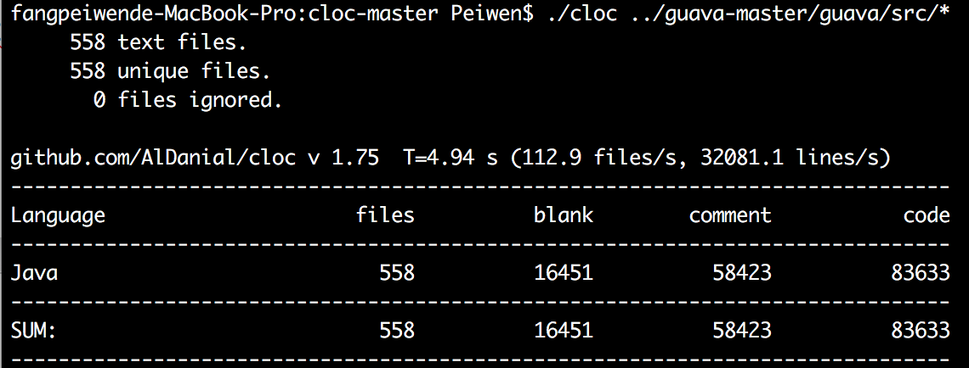
Line of codes
Introduction
Basic Utilities
Line of codes
Collections
Graphs
Caches
Concurrency
Strings
Networking
Primitives
Ranges
I/O
Hashing
EventBus
Math
Reflection

Slide 16
Collections
Introduction
Basic Utilities
Line of codes
Collections
Graphs
Caches
Concurrency
Strings
Networking
Primitives
Ranges
I/O
Hashing
EventBus
Math
Reflection
Immutable collections
New collection types
Powerful collection utilities
Extension utilities

Slide 17
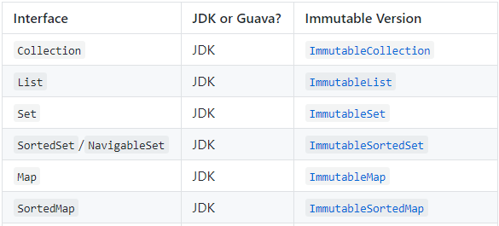
Collections (1/4) ----Immutable Collections
Introduction
Basic Utilities
Line of codes
Collections
Graphs
Caches
Concurrency
Strings
Networking
Primitives
Ranges
I/O
Hashing
EventBus
Math
Reflection
A great defensive programming technique
Advantages
Thread-safe
More efficient than their mutable siblings

Slide 18
Collections (2/4) ----New Collection Types
Introduction
Basic Utilities
Line of codes
Collections
Graphs
Caches
Concurrency
Strings
Networking
Primitives
Ranges
I/O
Hashing
EventBus
Math
Reflection
Multiset
Multimap
BiMap
Table
RangeSet
RangeMap

Slide 19
Collections (3/4) ----Powerful Collection Utilities
Introduction
Basic Utilities
Line of codes
Collections
Graphs
Caches
Concurrency
Strings
Networking
Primitives
Ranges
I/O
Hashing
EventBus
Math
Reflection
Static constructor
Iterable
List
Set
Map
Multiset
Multimap
Table

Slide 20
Collections (4/4) ----Extension Utilities
Introduction
Basic Utilities
Line of codes
Collections
Graphs
Caches
Concurrency
Strings
Networking
Primitives
Ranges
I/O
Hashing
EventBus
Math
Reflection
Forwarding decorators
PeekingIterator
Peek next element
AbstractIterator
Implement your own iterators

Slide 21
Graphs
Introduction
Basic Utilities
Line of codes
Collections
Graphs
Caches
Concurrency
Strings
Networking
Primitives
Ranges
I/O
Hashing
EventBus
Math
Reflection
3 types:
Graph
Value graph
Network
Graph builder:
do/not allow directed
self-loops
sorted edges

Slide 22
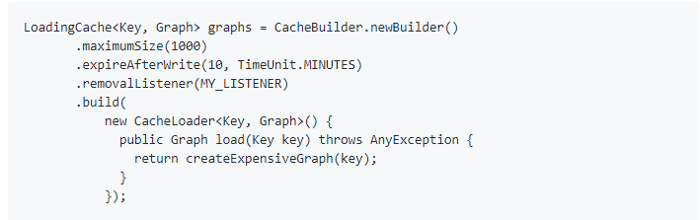
Caches (1/2)
Introduction
Basic Utilities
Line of codes
Collections
Graphs
Caches
Concurrency
Strings
Networking
Primitives
Ranges
I/O
Hashing
EventBus
Math
Reflection
A Cache is similar to ConcurrentMap.
ConcurrentMap: all elements that are added to it until removed.
Cache: generally configured to evict entries automatically

Slide 23
Caches (2/2)
Introduction
Basic Utilities
Line of codes
Collections
Graphs
Caches
Concurrency
Strings
Networking
Primitives
Ranges
I/O
Hashing
EventBus
Math
Reflection
Applicability
Population (CacheLoader, Callable,)
Eviction(Size-based, Timed-based, Reference-based)
Feature(Statistics, asMap)
Interruption

Slide 24
Concurrency
Introduction
Basic Utilities
Line of codes
Collections
Graphs
Caches
Concurrency
Strings
Networking
Primitives
Ranges
I/O
Hashing
EventBus
Math
Reflection
ListenableFuture
Service

Slide 25
Concurrency (1/2) ----ListenableFuture
Introduction
Basic Utilities
Line of codes
Collections
Graphs
Caches
Concurrency
Strings
Networking
Primitives
Ranges
I/O
Hashing
EventBus
Math
Reflection
Concurrency is a hard problem, but it is significantly simplified by working with powerful and simple abstractions. To simplify matters, Guava extends the Future interface of the JDK with ListenableFuture.
A ListenableFuture allows you to register callbacks to be executed once the computation is complete, or if the computation is already complete, immediately. This simple addition makes it possible to efficiently support many operations that the basic Future interface cannot support.

Slide 26
Concurrency (2/2) ----Service
Introduction
Basic Utilities
Line of codes
Collections
Graphs
Caches
Concurrency
Strings
Networking
Primitives
Ranges
I/O
Hashing
EventBus
Math
Reflection
The Guava Service interface represents an object with an operational state, with methods to start and stop.
Thread 5 state:
Service.State.NEW
Service.State.STARTING
Service.State.RUNNING
Service.State.STOPPING
Service.State.TERMINATED

Slide 27
Strings
Introduction
Basic Utilities
Line of codes
Collections
Graphs
Caches
Concurrency
Strings
Networking
Primitives
Ranges
I/O
Hashing
EventBus
Math
Reflection
Jointer
Splitter
CharMatcher
CaseFormat

Slide 28
Strings (1/4) ----Jointer
Introduction
Basic Utilities
Line of codes
Collections
Graphs
Caches
Concurrency
Strings
Networking
Primitives
Ranges
I/O
Hashing
EventBus
Math
Reflection
Use splitter character to link several Strings
If joint member is not a String, it will link it with the toString() value
Joiner joiner = Joiner.on("; ").skipNulls();
return joiner.join("Harry", null, "Ron", "Hermione");
Joiner.on(",").join( Arrays.asList(1, 5, 7) ); // returns "1,5,7"

Slide 29
Strings (2/4) ----Splitter
Introduction
Basic Utilities
Line of codes
Collections
Graphs
Caches
Concurrency
Strings
Networking
Primitives
Ranges
I/O
Hashing
EventBus
Math
Reflection
Splitter.on()
Use input char, String or Pattern as split rule
omitEmptyStrings()
Ignore empty String in result
trimResults()
Remove blank before and after the result string
Splitter.on(',’)
.trimResults()
.omitEmptyStrings()
.split("foo,bar,, qux");

Slide 30
Strings (3/4) ----CharMatcher
Introduction
Basic Utilities
Line of codes
Collections
Graphs
Caches
Concurrency
Strings
Networking
Primitives
Ranges
I/O
Hashing
EventBus
Math
Reflection
Determines a true or false value for any Java char value, just as Predicate does for any Object.
Operation in CharMatcher
Trimming
Collapsing
Removing
…

Slide 31
Strings (4/4) ----CaseFormat
Introduction
Basic Utilities
Line of codes
Collections
Graphs
Caches
Concurrency
Strings
Networking
Primitives
Ranges
I/O
Hashing
EventBus
Math
Reflection
CaseFormat is a handy little class for converting between ASCII case conventions like, for example, naming conventions for programming languages.
Supported formats include:
Format | Example
LOWER_CAMEL | lowerCamel
LOWER_HYPHEN | lower-hyphen
LOWER_UNDERSCORE | lower_underscore
UPPER_CAMEL | UpperCamel
UPPER_UNDERSCORE | UPPER_UNDERSCORE

Slide 32
Networking
Introduction
Basic Utilities
Line of codes
Collections
Graphs
Caches
Concurrency
Strings
Networking
Primitives
Ranges
I/O
Hashing
EventBus
Math
Reflection
InternetDomainName is a useful tool for parsing and manipulating domain names. It can be used as a validator, a component extractor, and as a value type for passing around domain names in a type-safe way.
We can use InternetDomainName to determine whether a given string represents a plausibly addressable domain on the Internet, and to determine what portion of a domain is likely to allow cookies to be set.
Methods: isPublicSuffix,isTopPrivateDomain, …
Notes:
There are methods on InternetDomainName to determine the relationship of a given domain to the PSL.
A "public suffix" is one under which Internet users can (or historically could) directly register names. Some examples of public suffixes are .com, .co.ukand pvt.k12.ma.us. The Public Suffix List is a list of all known public suffixes.
The Public Suffix List is an initiative of Mozilla, but is maintained as a community resource. It is available for use in any software, but was originally created to meet the needs of browser manufacturers.

Slide 33
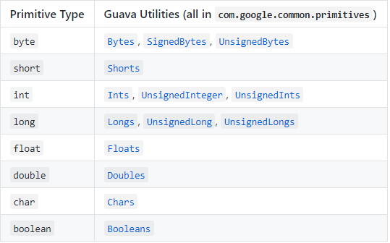
Primitives
Introduction
Basic Utilities
Line of codes
Collections
Graphs
Caches
Concurrency
Strings
Networking
Primitives
Ranges
I/O
Hashing
EventBus
Math
Reflection
Java: byte, short, int, float, double, char, boolean
These types cannot be used as object or as type parameter to generic types.

Slide 34
Primitives
Introduction
Basic Utilities
Line of codes
Collections
Graphs
Caches
Concurrency
Strings
Networking
Primitives
Ranges
I/O
Hashing
EventBus
Math
Reflection
Primitive array utilities
General utility methods
Byte conversion methods
Unsigned support (generic utilities, wrapper)

Slide 35
Ranges
Introduction
Basic Utilities
Line of codes
Collections
Graphs
Caches
Concurrency
Strings
Networking
Primitives
Ranges
I/O
Hashing
EventBus
Math
Reflection
(a..b) = {x | a < x < b}
[a..b] = {x | a <= x <= b}
[a..b) = {x | a <= x < b}
(a..b] = {x | a < x <= b}
(a..+∞) = {x | x > a}
[a..+∞) = {x | x >= a}
(-∞..b) = {x | x < b}
(-∞..b] = {x | x <= b}
(-∞..+∞) = all values
Interval Operations
Discrete domain

Slide 36

I/O (1/2)
Introduction
Basic Utilities
Line of codes
Collections
Graphs
Caches
Concurrency
Strings
Networking
Primitives
Ranges
I/O
Hashing
EventBus
Math
Reflection
ByteStreams and CharStreams
Utility classes that handle buffering themselves for efficiency
byte stream means InputStream or OutputStream
char stream means Reader and Writer
Sources and sinks
Streams, readers, writers objects and their providers
Providers retrieve and return streams
Sources are readable, while sinks are writable.
A source or sink is a resource of some sort that you know how to open a new stream to, such as a File or URL
e.g.

Slide 37
I/O (2/2)
Introduction
Basic Utilities
Line of codes
Collections
Graphs
Caches
Concurrency
Strings
Networking
Primitives
Ranges
I/O
Hashing
EventBus
Math
Reflection
e.g.
A ByteSource class represents a readable source of bytes. We can create ByteSource from a file object by using a static method from the Files class.
A ByteSink class represents a writable source of bytes. We can write the bytes to a file or another byte array.
The Files class offers several of the methods offered by the ByteSink and CharSink classes that work on files.

Slide 38
Hashing
Introduction
Basic Utilities
Line of codes
Collections
Graphs
Caches
Concurrency
Strings
Networking
Primitives
Ranges
I/O
Hashing
EventBus
Math
Reflection
HashFunction
Hasher

Slide 39
Hashing (1/2) ---- HashFunction
Introduction
Basic Utilities
Line of codes
Collections
Graphs
Caches
Concurrency
Strings
Networking
Primitives
Ranges
I/O
Hashing
EventBus
Math
Reflection
HashFunction is a stateless function that maps an arbitrary block of data to a fixed number of bits, with the property that equal inputs always yield equal outputs, and unequal inputs yield unequal outputs as often as possible.

Slide 40
Hashing (2/2) ---- Hasher
Introduction
Basic Utilities
Line of codes
Collections
Graphs
Caches
Concurrency
Strings
Networking
Primitives
Ranges
I/O
Hashing
EventBus
Math
Reflection
A HashFunction can be asked for a stateful Hasher, which provides fluent syntax to add data to the hash and then retrieve the hash value.
A Hasher can accept any primitive input, byte arrays, character sequences
Hasher implements the PrimitiveSink interface, which specifies a fluent API for an object that accepts a stream of primitive values.

Slide 41
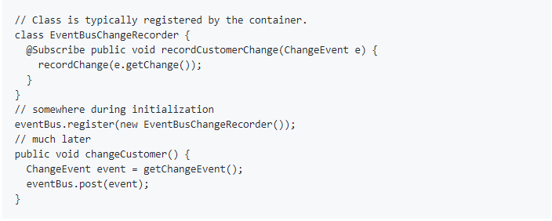
EventBus (1/2)
Introduction
Basic Utilities
Line of codes
Collections
Graphs
Caches
Concurrency
Strings
Networking
Primitives
Ranges
I/O
Hashing
EventBus
Math
Reflection
Publish-subscribe-style communication between components without requiring the components to explicitly register with one another.
It is not a general-purpose publish-subscribe system.

Slide 42
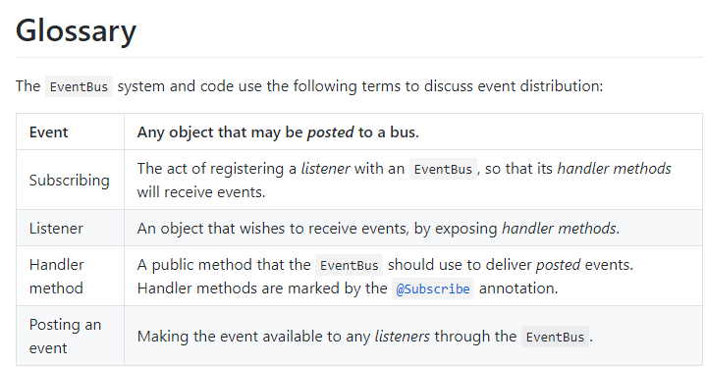
EventBus (2/2)
Introduction
Basic Utilities
Line of codes
Collections
Graphs
Caches
Concurrency
Strings
Networking
Primitives
Ranges
I/O
Hashing
EventBus
Math
Reflection

Slide 43
Math
Introduction
Basic Utilities
Line of codes
Collections
Graphs
Caches
Concurrency
Strings
Networking
Primitives
Ranges
I/O
Hashing
EventBus
Math
Reflection
Check Overflow
More readable(than java.lang,…)
Fast(as Apache common, MathUtils)
Additional functions besides JDK

Slide 44
Reflection
Introduction
Basic Utilities
Line of codes
Collections
Graphs
Caches
Concurrency
Strings
Networking
Primitives
Ranges
I/O
Hashing
EventBus
Math
Reflection
TypeToken
Invokable
Dynamic Proxies
ClassPath

Slide 45
Reflection (1/2)
Introduction
Basic Utilities
Line of codes
Collections
Graphs
Caches
Concurrency
Strings
Networking
Primitives
Ranges
I/O
Hashing
EventBus
Math
Reflection
TypeToken
allows you to detect the generic types of methods and classes, even at runtime
supports non-reified types such as T, List<T> or even List<? extends Number>
e.g.
Dynamic Proxies
a type safer and more convenient API to create Java dynamic proxies when only a single interface type is to be proxied.
 | Java | Guava
Type | ArrayList<String> | List<String>
Return type | ArrayList<Object> | List<String> (ParameterizedType)

Slide 46
Reflection (2/2)
Introduction
Basic Utilities
Line of codes
Collections
Graphs
Caches
Concurrency
Strings
Networking
Primitives
Ranges
I/O
Hashing
EventBus
Math
Reflection
Invokable
a fluent wrapper of java.lang.reflect.Method and java.lang.reflect. Constructor which simplifies common reflective code using either. e,g.
ClassPath
a utility that offers best-effort class path scanning.
able to go through all classes under a certain package or project
only scans classes in jar files or under a file system directory, so we’d better not use it for mission critical production tasks.
JDK | Invokable
Modifier.isPublic(method.getModifiers()) | invokable.isPublic()

Slide 47
Thanks!
Any questions?

